Slide 1
Towards Research for Beginners: A Case Study
講者 : Sheng-Lung Peng
日期 : 2025/04/22
學生 : 陳郁君

Slide 2
Outline
Feedback
Keywords
References

Slide 3
Feedback

Slide 4
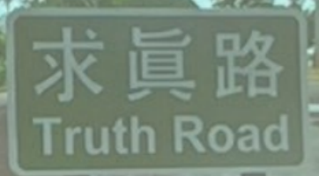
Feedback
今天的報告主題聚焦於如何開始進行研究，並以具體案例說明整個研究流程。對我而言，這場演講不僅系統性地梳理了研究的步驟，更提供了許多實用的思維與技巧，從「介紹、如何研究、案例研究、相關問題、結論」，還有詳細說明解決問題的的科學方法，從「觀察、認出、定義、假設、預言、實驗」，到案例研究「發現一個有趣的問題、進行文獻研究、解決問題、結論/未來的工作」，也分享了關於"Graph coloring"相關研究，如何找文獻做假設，聽完這場講座不僅幫助我建立做研究的基本框架與步驟，更讓我重新思考了「研究的價值與本質」。
未來我希望能將今天學到的觀念應用在自己的學術旅程中，不僅是完成一篇論文而已，更是在過程中提升獨立思考與問題解決的能力(特別是在實作的能力上)，演講的最後教授還鼓勵我們"相信自己有能力做研究"，讓我對研究又充滿了衝勁!!!!!!!

Slide 5
Keywords

Slide 6
Research
Research is a road for finding truths(new knowledge)
Research is also a road for solving problems
Doing researching is on the way towards the truck road

Slide 7
Solving the problem
Propose an algorithm for the problem of inte

Slide 8
A Scientific Method for Solving Problems
Comprehensive version
Observation
Recognition
Definition
Hypothesis
Prediction
Experiment
Abbreviated version
Observation
Understanding the Problem
Hypothesis / Prediction
Computational/Design Thinking
Experiment
Algorithm Proof, Analysis, Implementation (for simulation)

Slide 9
A Scientific Method for Solving Problems
Observation : Observation is the first step of the Scientific Method. However, it can infiltrat scientific process - from the initial perception of a phenomenon, to proposing a solution, and right down to experimentation, where observation of the results is significant
Hypothesis : In scientific discipline, a hypothesis is a set of propositions set forth to explain the occurrence of certain phenomena. In daily language, a hypothesis can be interpreted as an assumption or guess
Experiment : In scientific discipline, an experiment is a test under controlled conditions to investigate the validity of a hypothesis. In everyday language, experiment can be interpreted as a testing of an idea

Slide 10
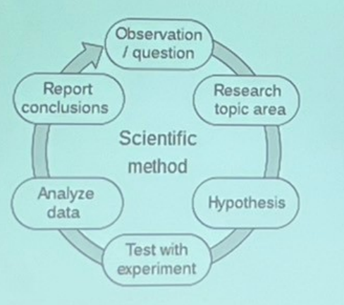
A Scientific Method for Solving Problems
The scientific method is Report often represented as an conclusions Scientific ongoing process. This diagram represents one Analyze method data variant, and there are Test with many others

Slide 11
Research Features
Category | Characteristic | Method
mathematicians | usually care whether the problem has a solution or not | Mathematical proof
computer scientists | typically work on the theoretical side Mathematical proof | Mathematical proof or analysis
computer engineers | typically propose a feasible solution to a practical problem | Experiment by simulation

Slide 12
Research Features
Mathematics
Computer Science
Engineering

Slide 13
How to do research?
Re-search is a searching process,again and again
Search an interesting topic
Narrow to an interesting problem
Survey all existing solutions
Propose a new solution or improve an old solution
Show its efficiency or feasibility
Theoretical analysis or
Experimental study
Make a conclusion

Slide 14
A Case Study
Finding an interesting problem
Conducting a literature review
Solving the problem
Conclusion / Future work

Slide 15
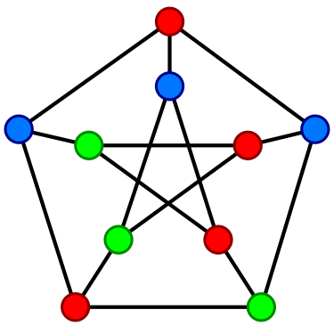
Graph Coloring
Let G = (V,E) be a graph with vertex set V and edge set E
A function f : V→{1,2,....,k} is a k-coloring of G if for any edge (u,v)∈E , f(u)≠f(V)

Slide 16
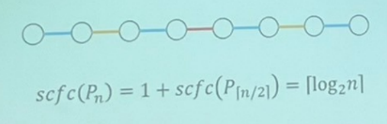
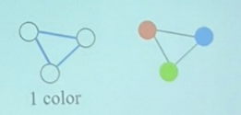
Strong Conflict-free Connection Coloring Problem
A conflict-free shortest path is a colored path with some color that occurs on exactly one edge on the path
Given a graph G and an integer k, the problem is to ask whether G is k-orable such that every two vertices have a conflict-free shortest path

Slide 17
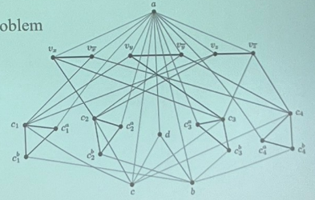
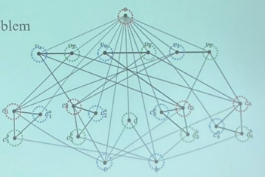
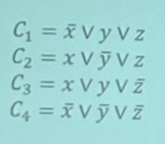
NP-Hardness Result
Reduction from 3-SAT Problem
Theorem: 3-svcfc problem is NP-Hard on 3-colorable graphs

Slide 18
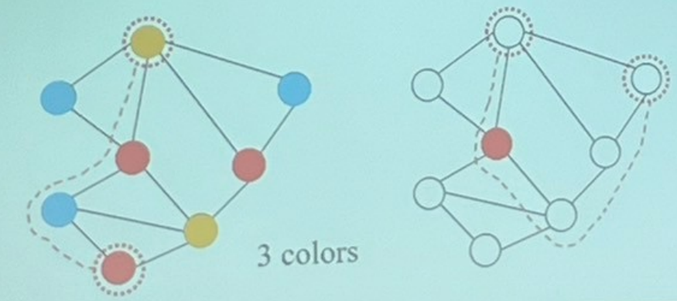
Conflict-free Vertex-connection Coloring Problem
A conflict-free path is a colored path with some color that occurs on exactly one vertex on the path
Given a graph G and an integer k, the problem is to ask whether G is k-colorable such that every two vertices have a conflict-free path

Slide 19
Conclusion
Believe that you have an ability to do research
Be patient
Be passionate
I do it, you can do it
Just do it

Slide 20
Reference

Slide 21
References
[1] J.Czap, S. Jendrol, L. Valiska. (2018), Conlict-free connections of graphs. Discuss. Math. Graph Theory 38(4):911-920
[2]DK Mak et al., Solving Everyday Problems with the Scientic Method, World Scientic, 2%, 2017
[3]X Li, Y. Zhang, X Zhu, Y. Mao, IL Zhao, S. S. (2020).Conlict-free vertexcomnections of graphs. Discuss. Math.Graph Theory 40(1): 51-65
[4]M.Ji, X. Li. (2020). Strong Conlict-frce conncetions of graphs. Appl. Math. Comput. 364

